Slide 1
Online Smart Service (OSS)
System provided by Growatt
SHENZHEN GROWATT NEW ENERGY CO.,LTD

Slide 2
Dedicated to Becoming
The World’s Largest Supplier of Smart Energy Solutions
Notes:
Growatt focus on PV new energy industry, our vision is “Dedicated to becoming the world’s largest supplier of smart energy solutions”.

Slide 3
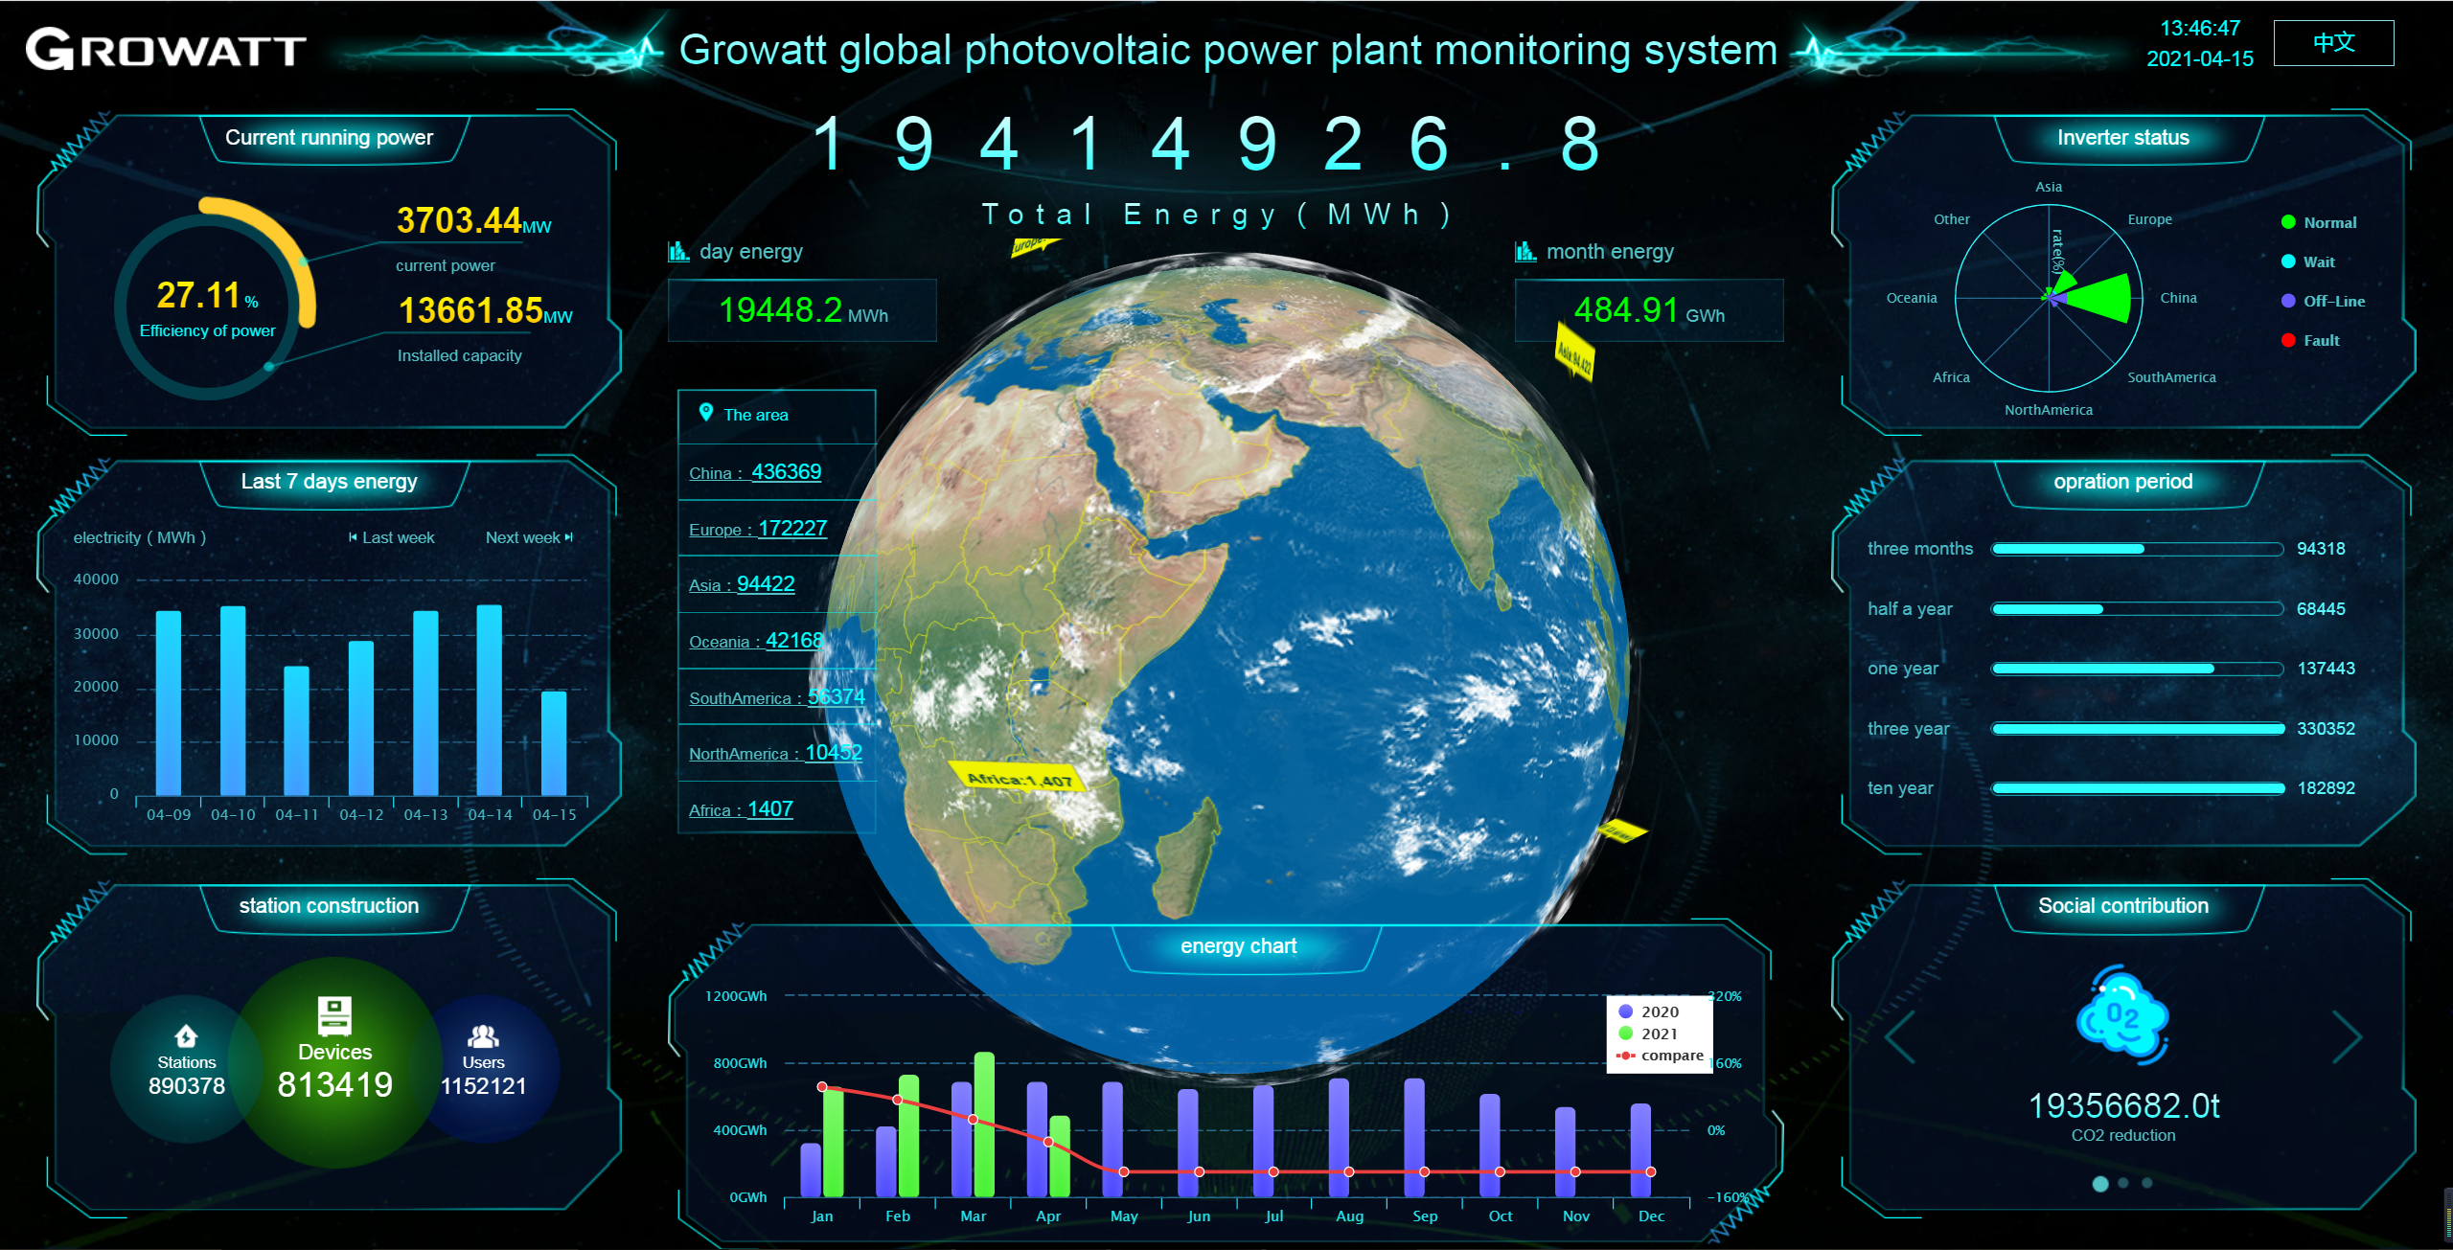
CONTENTS
01
02
03
04
05
06
Challenges of Modern PV Plants
The Importance of Smart System
Growatt Intelligent Solutions
OSS System------the core of the intelligent solution
The Usage of OSS System
Smart Service

Slide 4
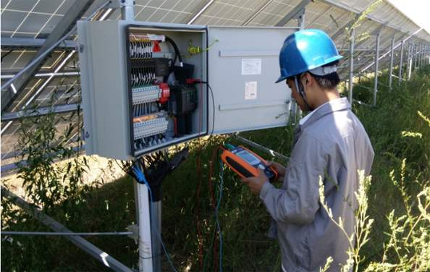
01
Challenges of Modern PV Plants

Slide 5
Systematic Management
The number of plants, users and devices is huge,
how to manage the system is a big problem
So many plants!
So many users!
So many devices!
How to manage?
How to service?
How to find?

Slide 6
Data Collection and Analysis
Modern plants need to be frequently dispatched and controlled according to the situation, so it must be supported by comprehensive information and multi-angle analysis
Complex plant data require a long time to sort out and analyze

Slide 7
High Inspection and Maintenance Costs
The large and scattered plants require a lot of manpower for regular maintenance, the cost is also a large number

Slide 8
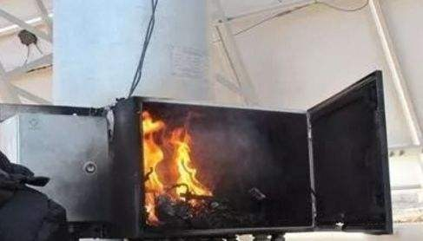
Emergency Service
Many modern power plants have complex environments, sometimes
the problem happened very quickly, it’s too late when the user find
the problem and call the services
We’re sorry the number you have reached is not in service at this time
Not to mention, sometimes there is no people answer the phone!

Slide 9
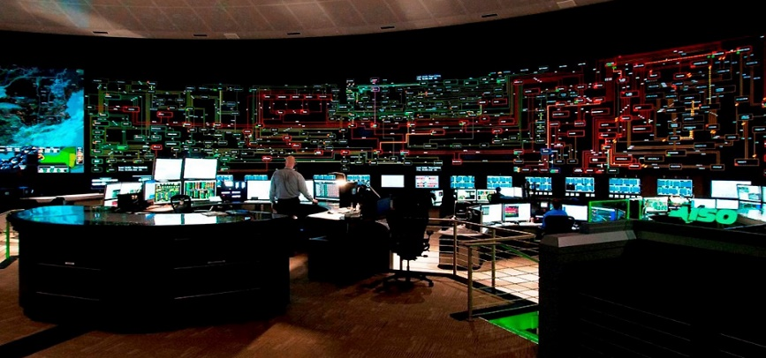
02
The Importance of Smart System

Slide 10
The Importance of Smart System
Nowadays, the PV system is not only a power generation system, but also an intelligent energy system, in order to achieve remote monitoring, operation and maintenance, a smart system is necessary.
Detailed data
The more you know about your plant, the better you can do the operation
Advanced remote setting
The more you can set remotely, the easier and quicker you can operate the plant, also you can save the cost of people for on-site operation.
Full around diagnosis
The quick & full around plant diagnosis can help you locate the problem and find the solution immediately, which can keep the plant working stalely in long term.

Slide 11
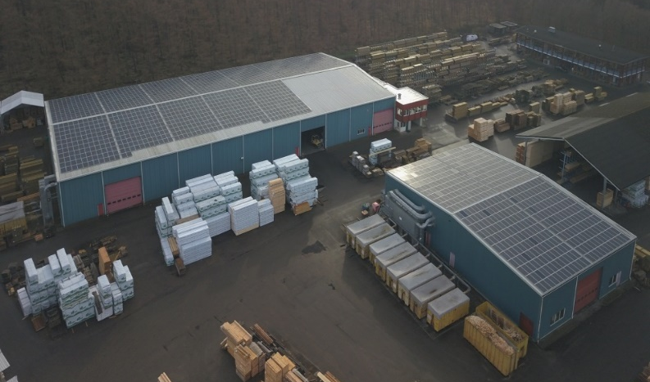
The Importance of Smart System
Due to COVID-19, many people cannot go to work, in this special time, it is important for the plant operators to own a smart system, which help them maintain the stability of plant

Slide 12
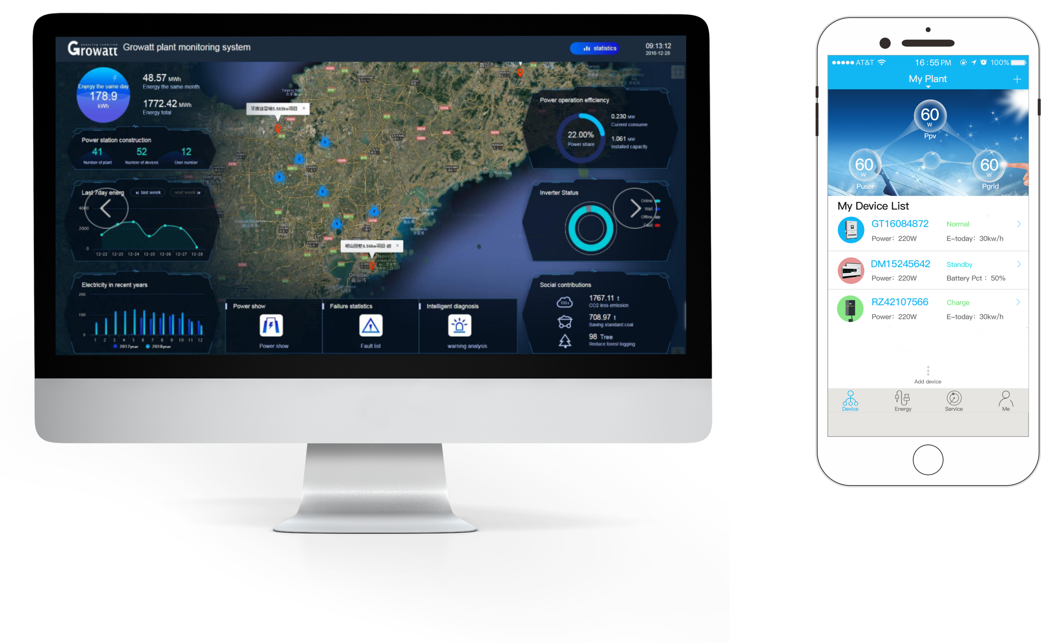
03
Growatt Intelligent Solutions

Slide 13
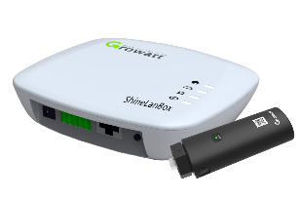
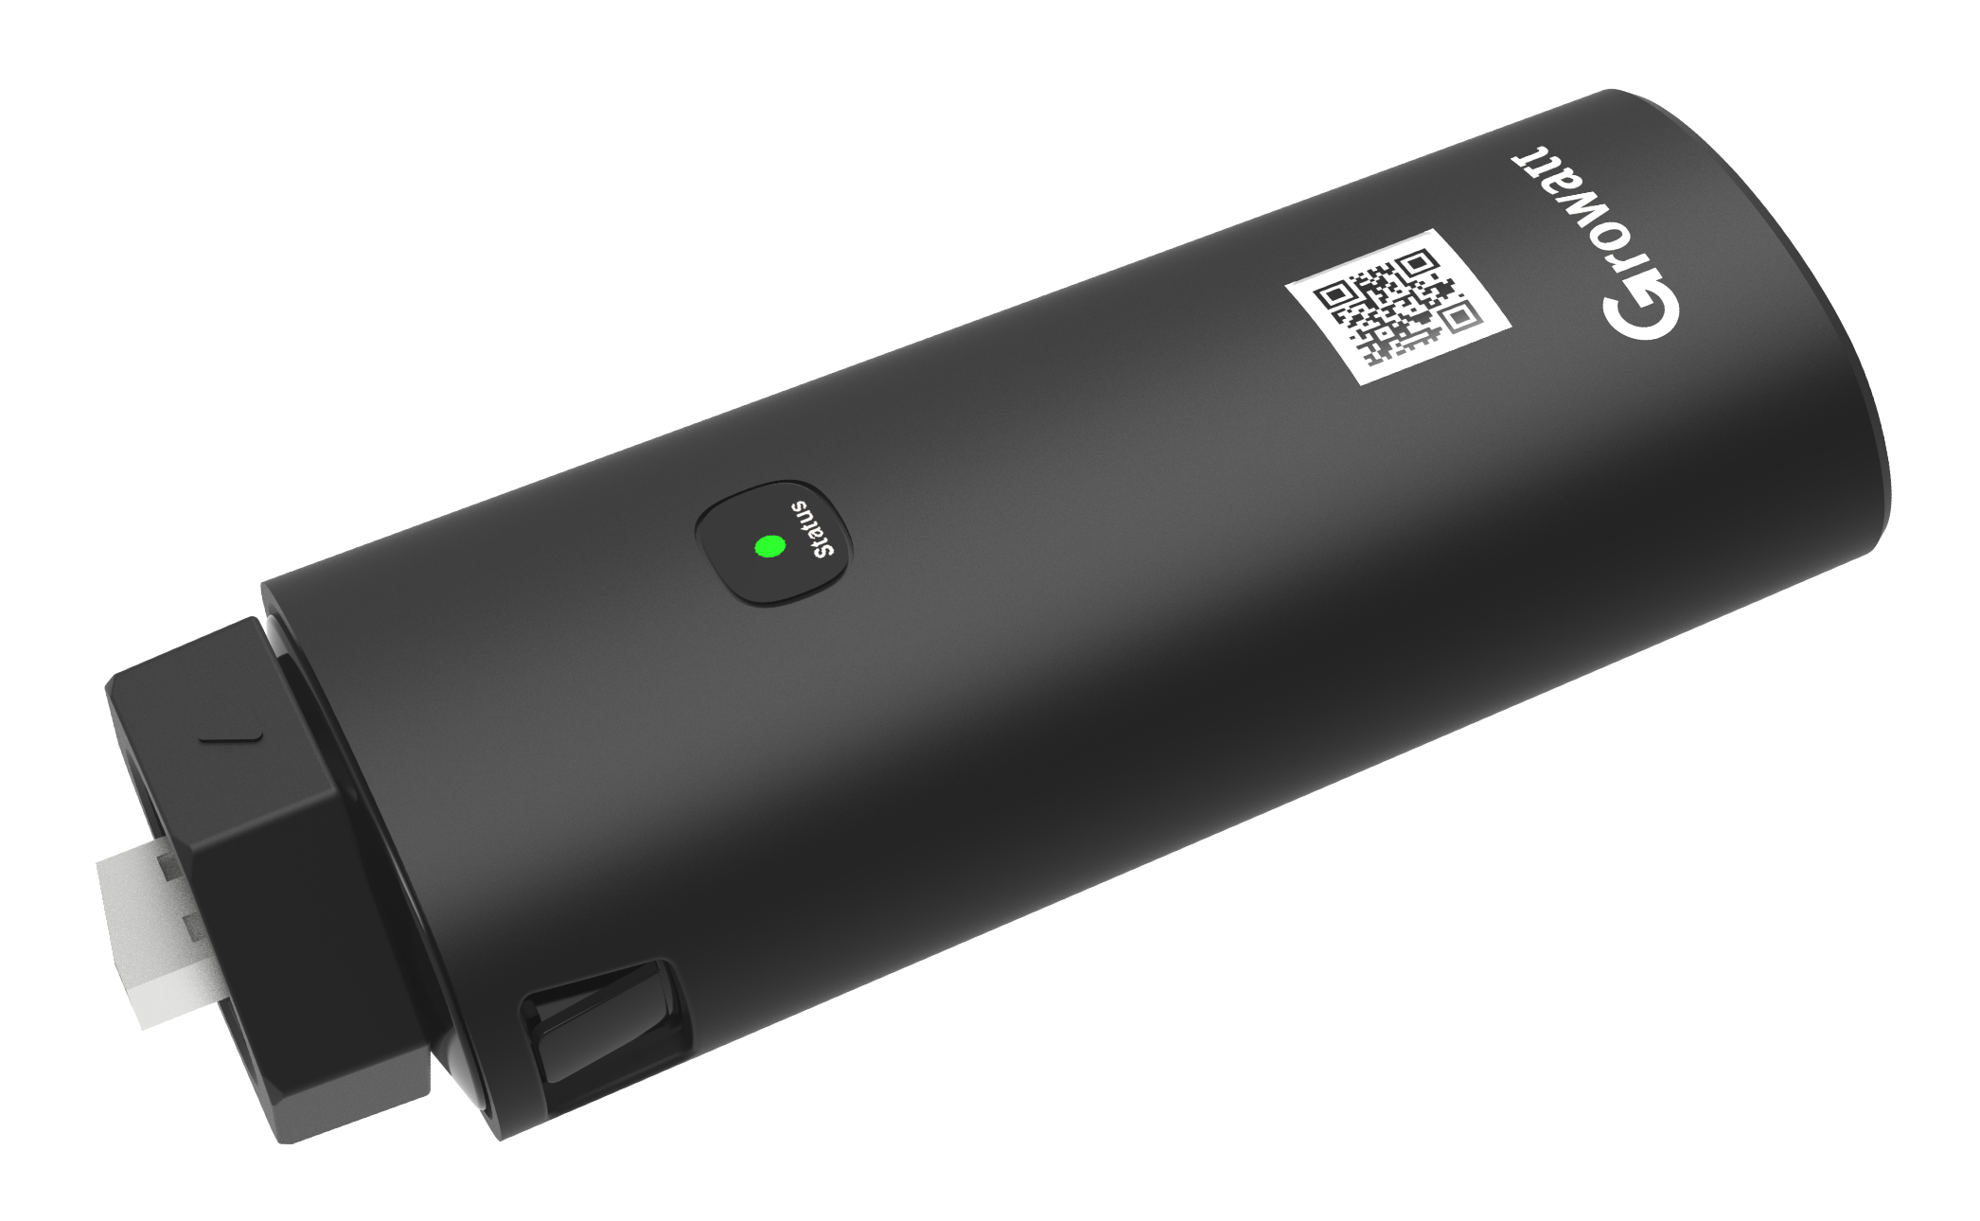
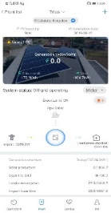
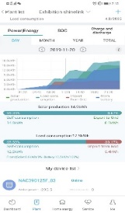
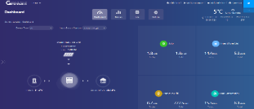
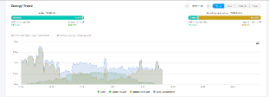
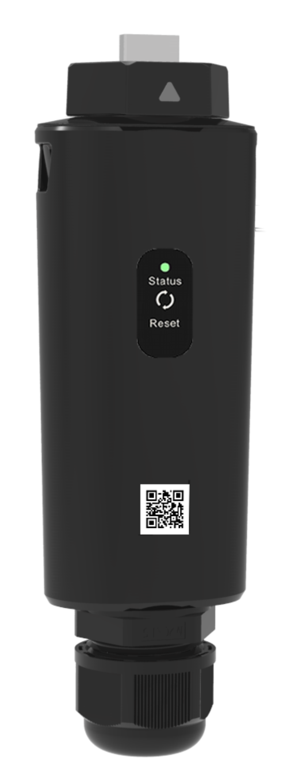
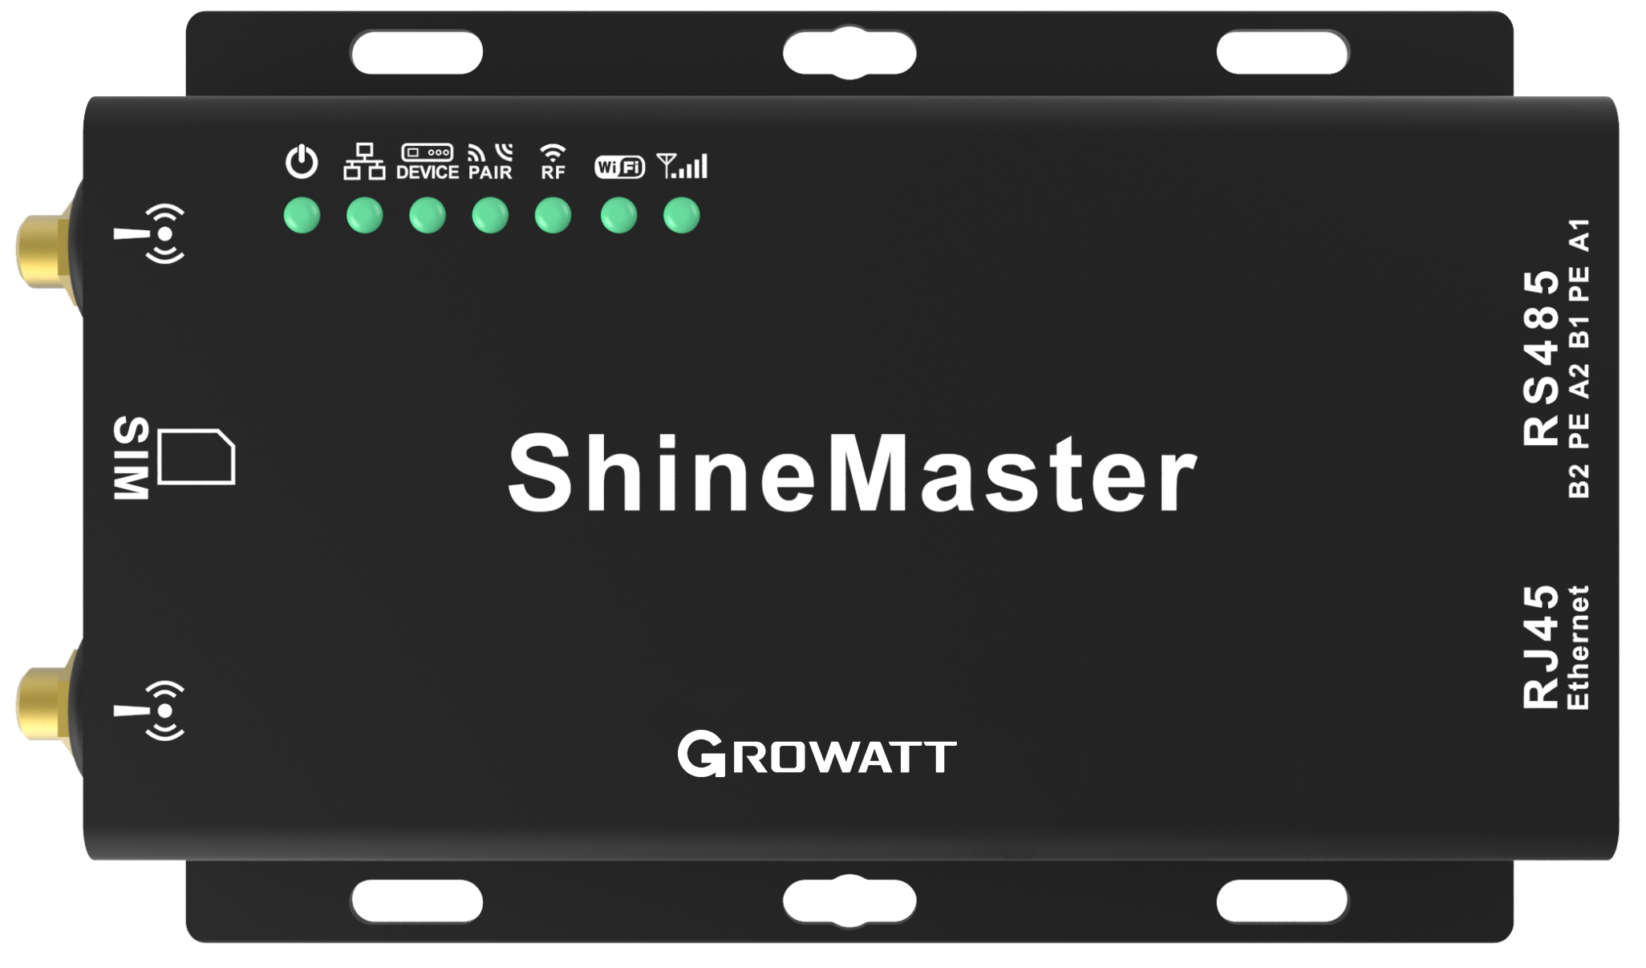
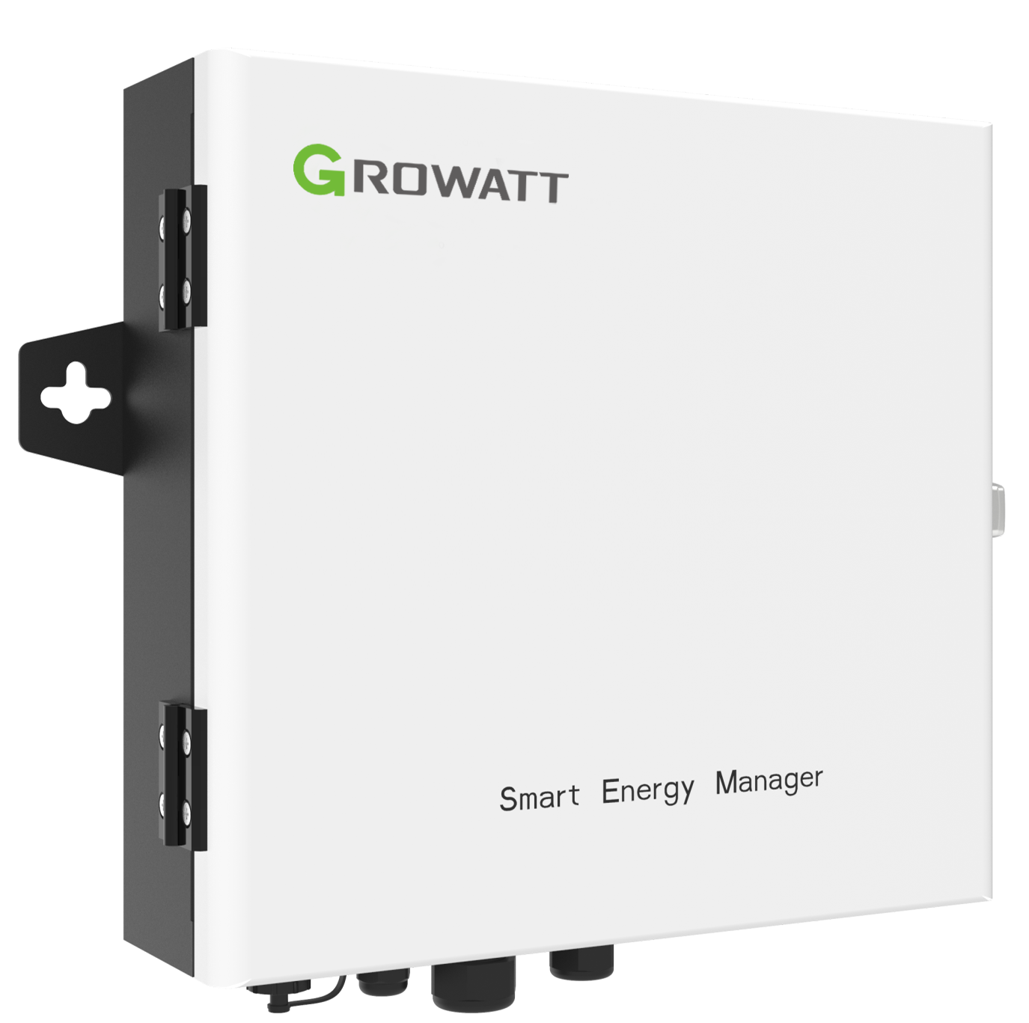
Growatt Intelligent Solution
Monitoring Devices
Monitoring Platform
ShineLink /-X
ShineWiFi/GPRS/
4G (-S/-X/-F)
ShineServer system
ShinePhone APP
ShineLan-X
ShineMaster /-4G
OSS
Smart Energy Manager

Slide 14
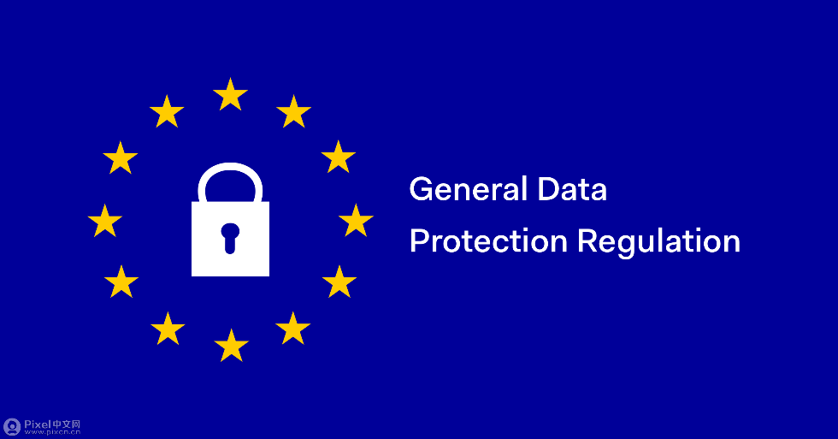
Data Security
Growatt always pays great attention to data security,
Database is in European Union, located in Frankfurt , Germany
Comply with GDPR
Growatt monitoring platform complies with GDPR
with SGS guidance.
Secure communication
Encrypted transfer of data to the solar portal
Data encryption in line with SSL and AES standard
General Data Protection Regulation (GDPR)

Slide 15
04
OSS System------
the Core of the Intelligent Solution

Slide 16
Advantages of OSS
Detail information
Detail statistics and analysis
Free
Free for all Growatt distributors and installers
Easy management
Different level and different way to manage all your devices and customers
Easy control
Remote parameter setting and firmware update
24*7
Keep scanning and always have engineers for service

Slide 17
05
The usage of OSS system

Slide 18
Diverse Management Methods
Distributor/installer can check their devices by plant, device & end user;
Comprehensive information
Including basic information, status, generation, etc..
Easy search
Fuzzy search function, using any information can help you
find what you want
Manage in group
Set in groups, batch management
More direct setup and management
Directly set the parameters, information and account

Slide 19
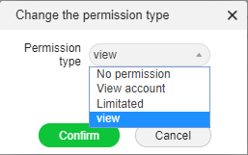
System User Manage
The system may be used by many people, to manage the people who use OSS, administrator can create sub-accounts with different permissions

Slide 20
Account Association
Installer account can be associated with distributor and managed by distributor when
installer agreed, the functions of installer account is nearly same as distributor account.

Slide 21
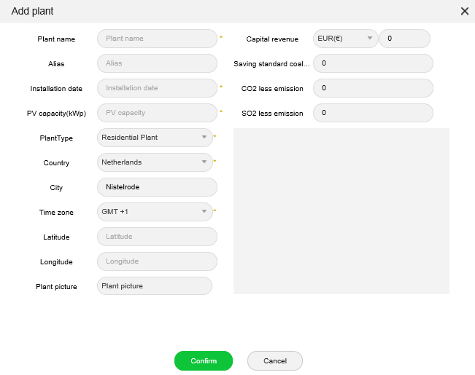
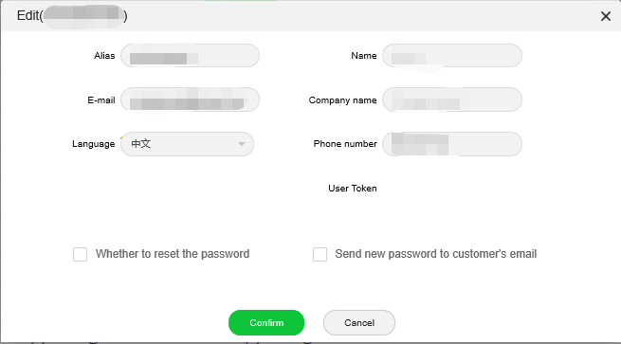
End User Management
Distributor & installer can manage the end user directly, you can help the customer to create plant and also help the customer to change the password directly when they forget.

Slide 22
Warranty Management
All the products will be automatically recorded in OSS system, including the warranty information, you can easily query the devices warranty by simple searching
Have a drink and relax~
Everything is under control!

Slide 23
Statistics and Analysis of Total Data
Dynamic statistical for plant and device level, include the power generation, revenue and
the running status of the system

Slide 24
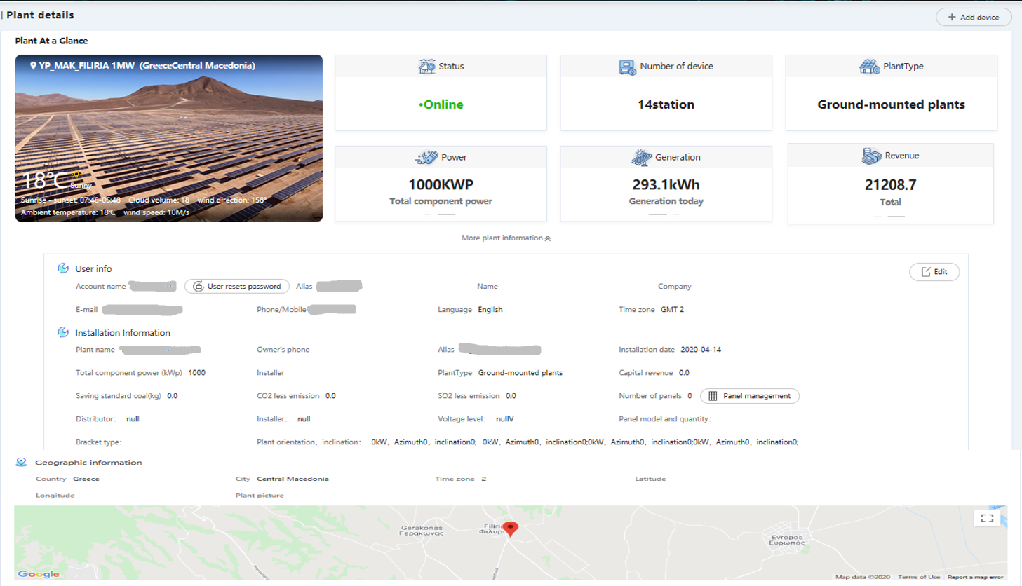
Statistics for Single Plant
Plant basic information & Location maps

Slide 25
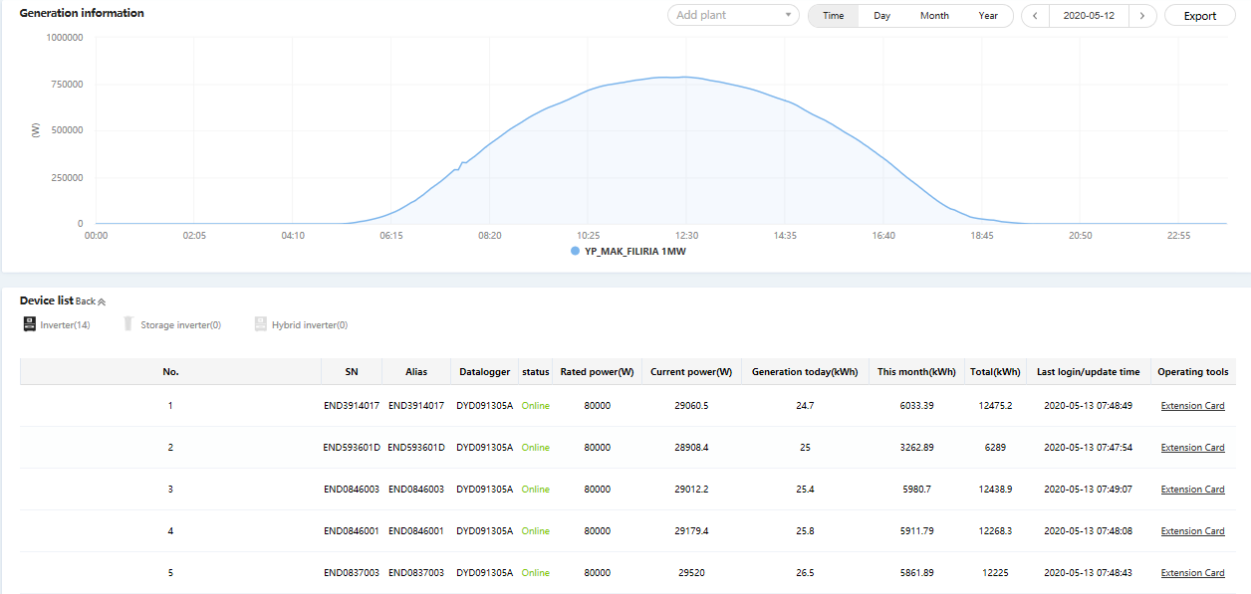
Statistics for Single Plant
Plant generation graph & devices information

Slide 26
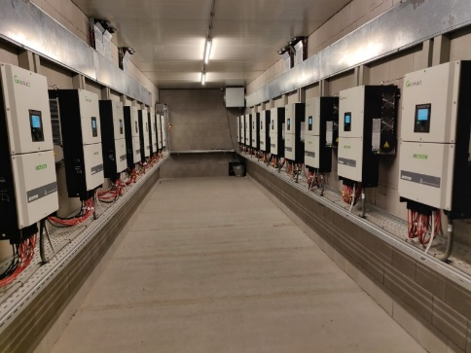
Statistics for Single Device
Device basic information, generation, revenue, historical data(every 5 mins) and
generation graph,also include the comparision between devices.

Slide 27
Statistics for Single User
User information, included plants, browsing user

Slide 28
Export Excel for Analysis
In the plant list, device list and end user list you can export the total information in Excel which is more easier for you to do analysis. Also when you enter into the single plant, device or user page you can also download the data in Excel of it.
Never need to calculate by myself !

Slide 29
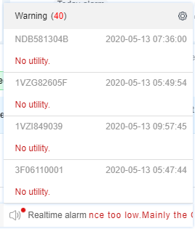
Scanning all Devices 24/7
The system will keep scanning all devices 24/7, once there is a problem the alarm will automatically be sent to customer, installer and distributor.
It is so smart that the system will not only show you what happened, but also show you some advices to help solve the issue.
Fault alarm detail and solutions
Fault Log
Real time alarm in OSS main page
Setting email to receive alarm

Slide 30
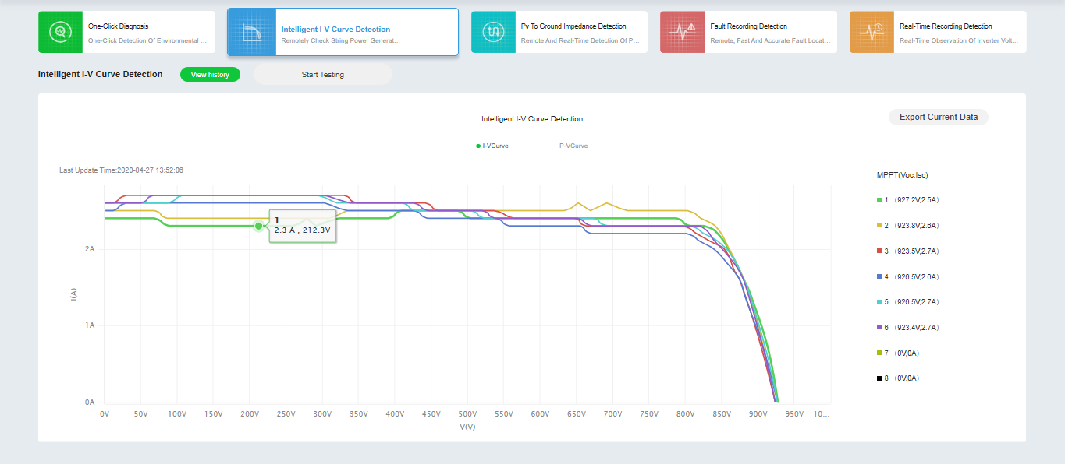
Various Remote Diagnosis Methods
For MAC, MAX series, you can use the diagnosis tool to do some test, it has many functions that can help you easily find what exactly happened!
YES!!
No need to hire people to inspect on sites!

Slide 31
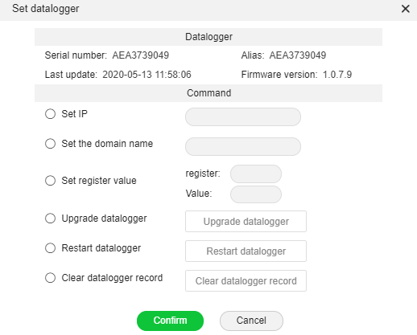
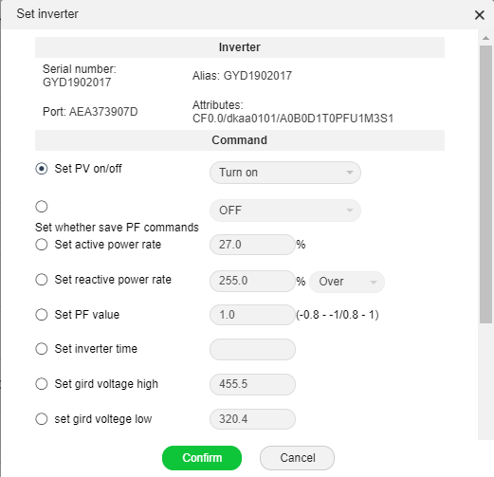
Different Level Access of Remote Setting
In OSS system, you can remotely and directly set many parameters of inverters
In addition, for the safety reason, professional engineers can through inverter register to set advanced parameters
More than 60% problems can be solved by remote setting
Set datalogger
Set inverter
Advanced setting

Slide 32
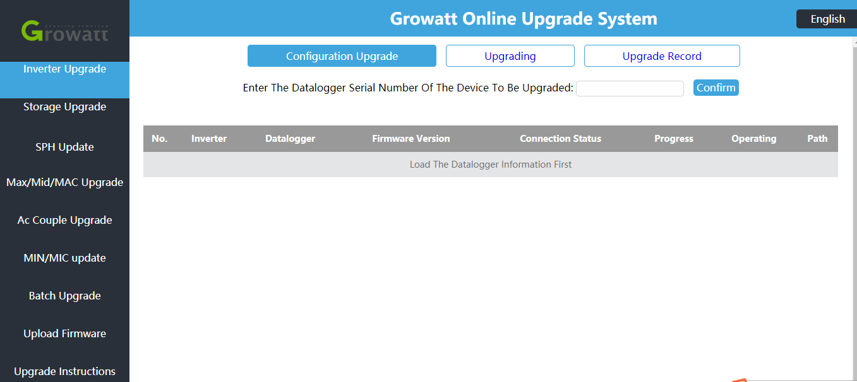
All Series Quick and Remote Upgrade
All Growatt inverters can be remotely upgraded in OSS, only 3 mins you can finish the upgrade
Keep your inverter in the latest version and the best running state
See !? Everything done here!
*Special function for the qualified installer/distributor

Slide 33
06
Smart Service

Slide 34
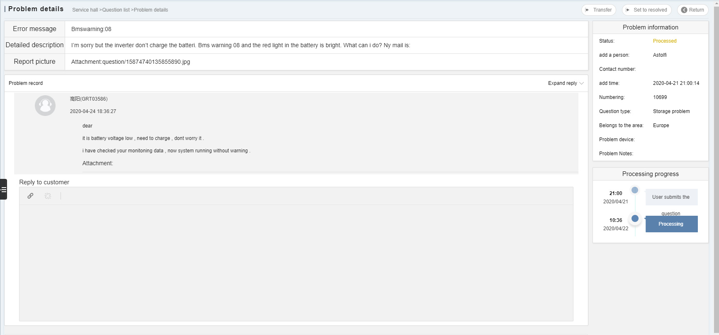
24/7 Online Service
200+ service engineers, 14 countries, 4 continents
Professional team with sufficient staff makes sure 24/7 online service
With the help of our powerful system, our professional engineers all over the world can even find problems earlier than customers
Hello？I have problem!

Slide 35
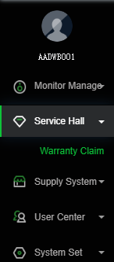
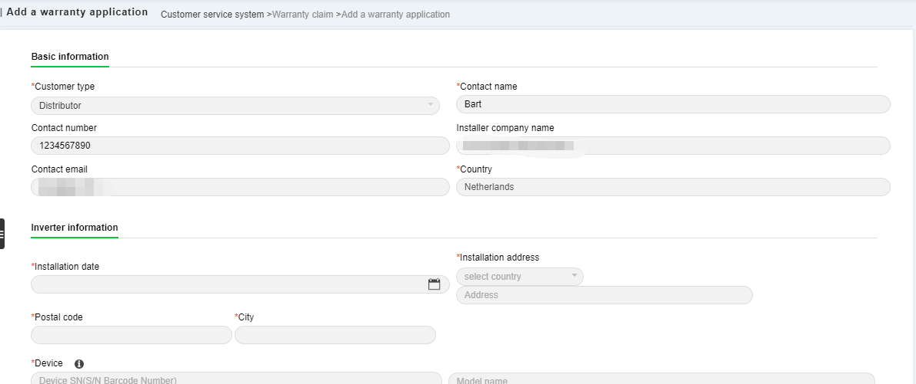
Warranty Claim
Online warranty claim
Make application of warranty online, our engineer will arrange it within 3 days
(3 days in the areas with local office, one week for other areas)

Slide 36
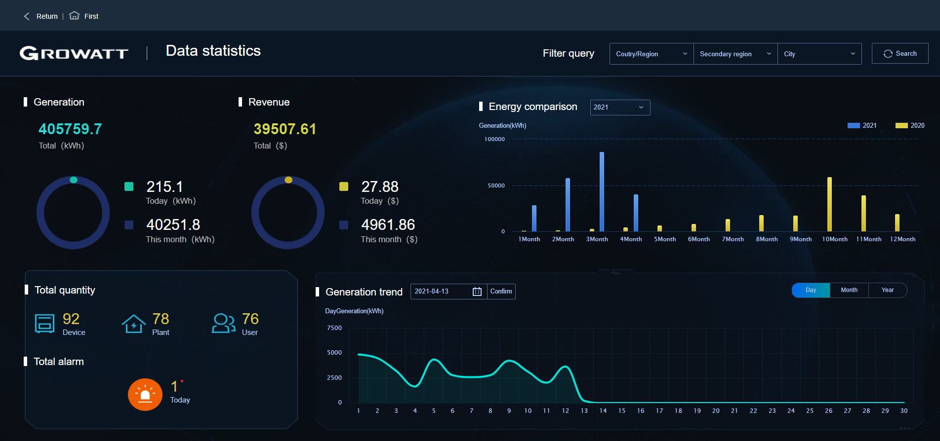
Big Screen Monitoring
One page for easy monitoring and shows what you accomplish
Diversified information display allows professionals to quickly analyze
An elegant and intuitive platform can show your strength to customer

Slide 37
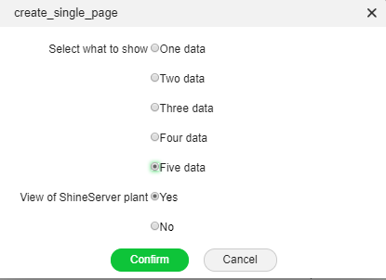
Create a link to embed on your webpage
Show your achievements in your own website in different languages

Slide 38
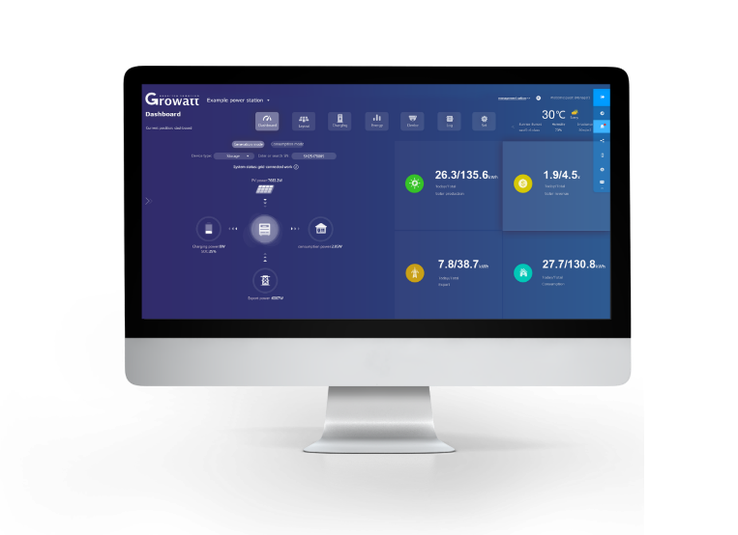
Simplify Operations
Simplify the O&M process，
Relax in your office！
Growatt OSS will help you guard all the plants!

Slide 39
THANKS
Copyright© 2021 Growatt New Energy CO., LTD
All Rights Reserved. The information contained in this document is only
for reference purpose and subject to change by company officials.
Notes:
That’s all about Growatt. In the last, I want to say thank you for your listening, together with Growatt, we can create a greener and smarter world.

