Slide 1
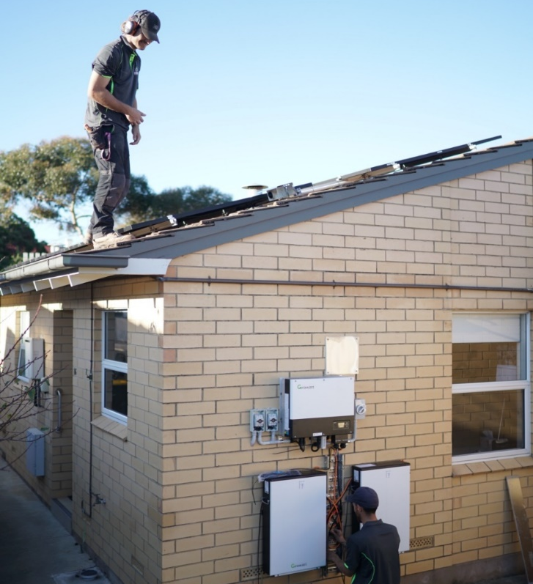


New Generation Hybrid Storage Inverter
SPH 3000-6000TL BL-UP
June, 2021
SHENZHEN GROWATT NEW ENERGY CO.,LTD

Slide 2

Dedicated to Becoming
The World’s Largest Supplier of Smart Energy Solutions

Slide 3
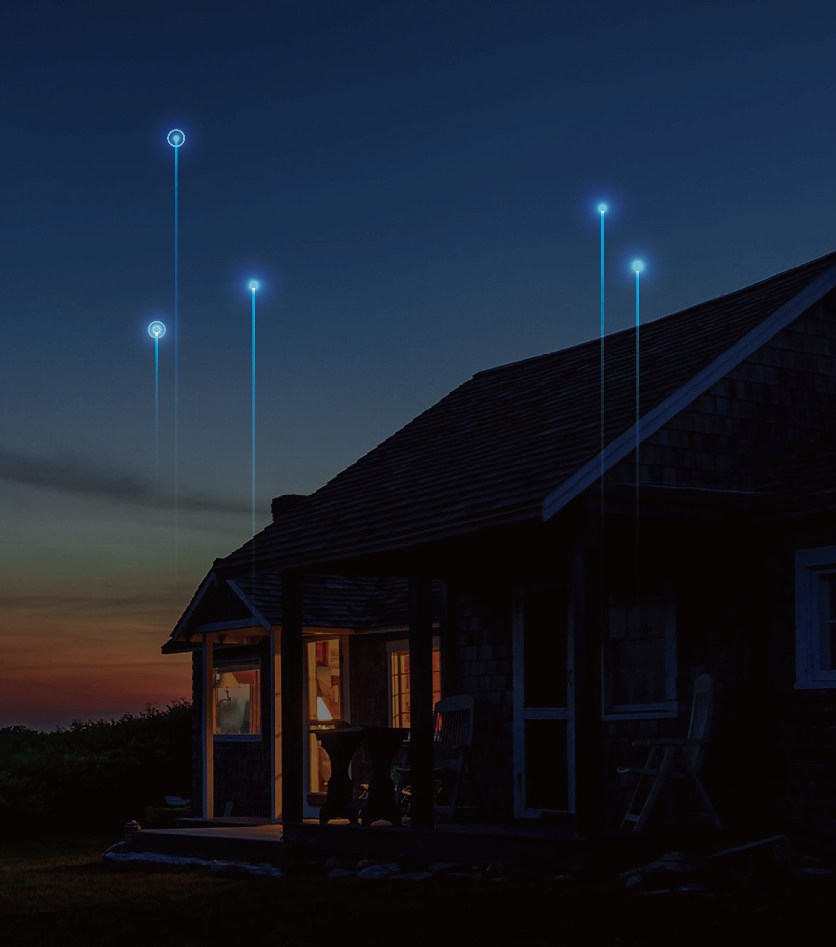
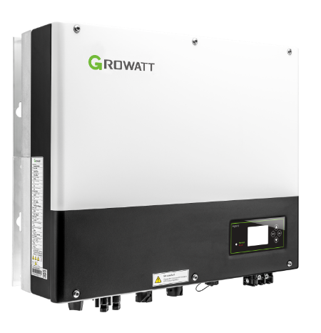
CONTENTS
01
02
03
04
Upgraded Features
Compatible Batteries
System Solutions
Work Mode & Benefits
Notes:
I will from these seven aspects to introduce them, hopefully it can offer a overall view of Growatt solution for all our partners.

Slide 4
Upgraded Features

Slide 5

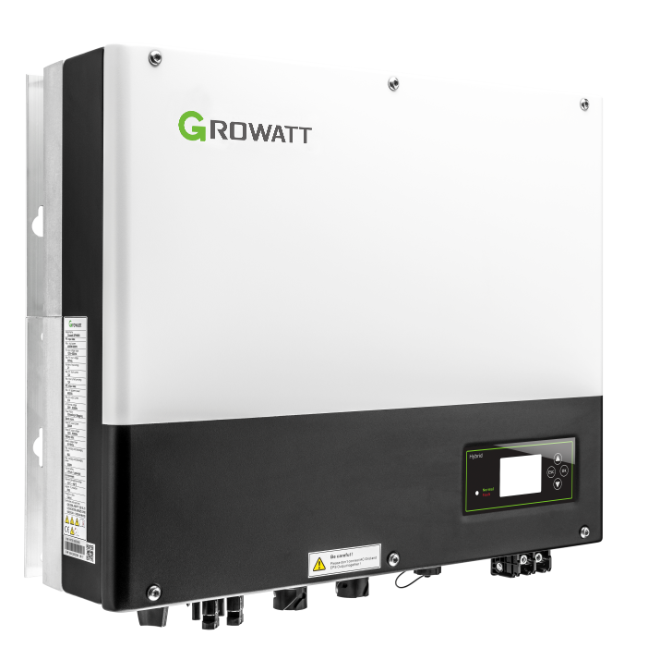
Upgraded Features
Key Features:
UPS function, 10ms transition
4kW charge/discharge power
4kW backup power
AC-coupled function compatible with third-party Inverter
1.5 DC/AC ratio, 6kW system with 9kW solar input
13.5A solar input current for high power modules
VPP interface ready
Scalable system configuration
Safety standard set by LCD directly
SPH 3000-6000TL BL-UP

Slide 6

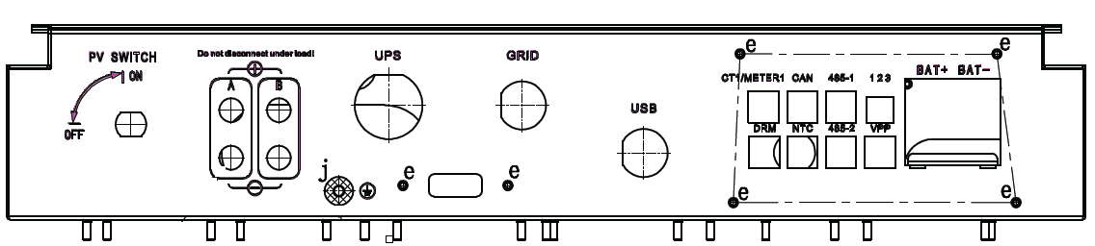


Upgraded Features – Multiple communication ports
Multiple communication ports are available for different application
Meter1/ShineMaster
Meter2
AC-Coupled application
Multiple storage inverter in parallel
VPP
VPP application
ShineMaster

Slide 7
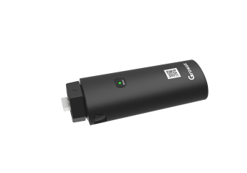
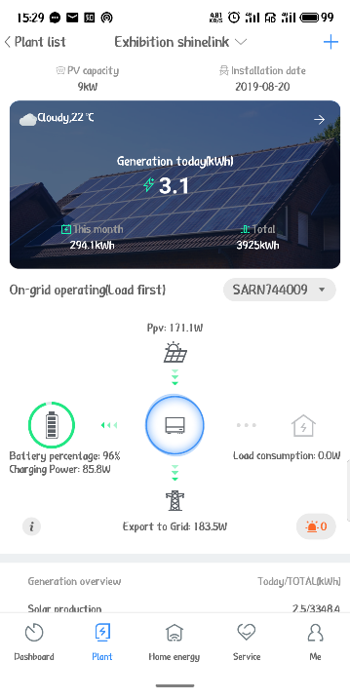
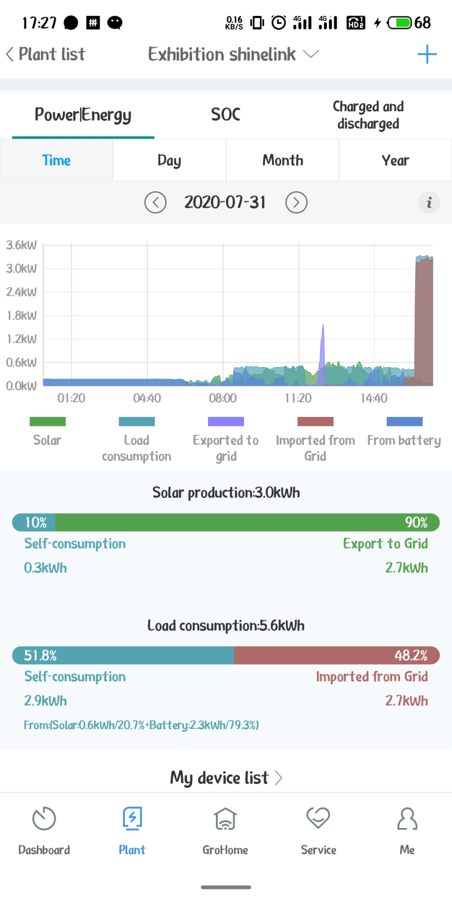
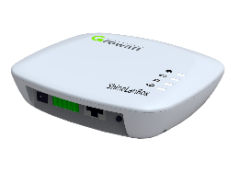
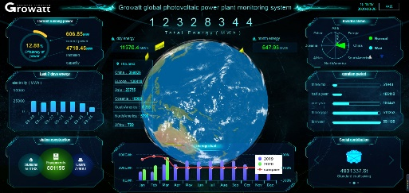
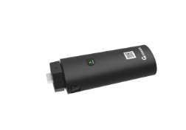
Upgraded Features – Support X series monitoring platform
Support –X series monitoring platform
ShineWiFi-X/GPRS-X
ShineLink-X
ShinePhone APP
ShineServer / OSS system
OSS system is a Smart management and service platform special for installers

Slide 8

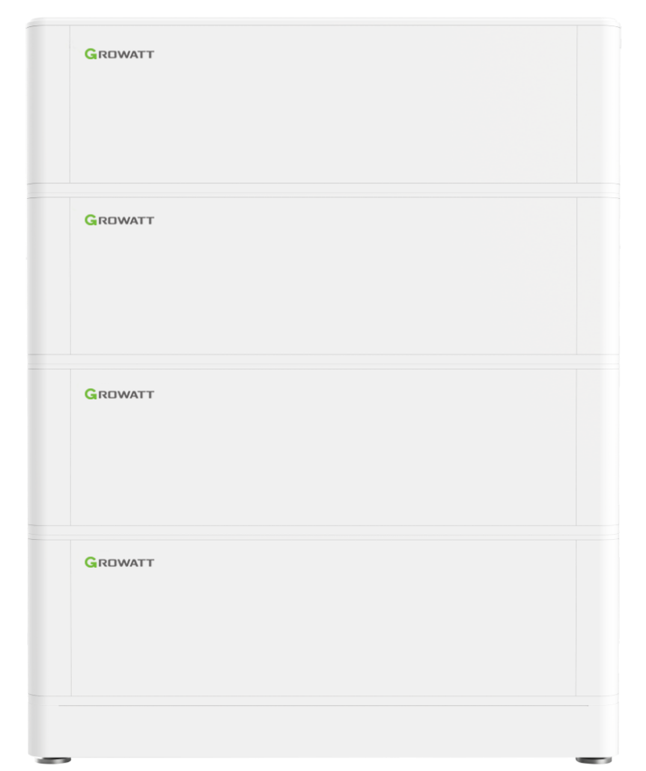
Compatible Battery – ARK 2.56L modular battery
ARK Low Voltage Battery System
Battery Module
ARK 2.5L
IP65, 2.56kWh / Module
Flexible capacity : 2.56kWh ~ 25.6kWh
Excellent safety of cobalt free LiFePO4 battery
Easy installation with modular and stacked design
Remote firmware upgrade
Notes:
1. This the modular Low voltage battery, ARK battery, which we promote mostly, single battery module is 2.56kWh, maximum 10 units in parallel reaching 25.6kWh
The materials of the battery is LPF, which guarantee its excellent safety, and easy installation with modular and stacked design.
Also the system supports remote firmware upgrade and monitoring, which can save the maintenance cost in site.

Slide 9
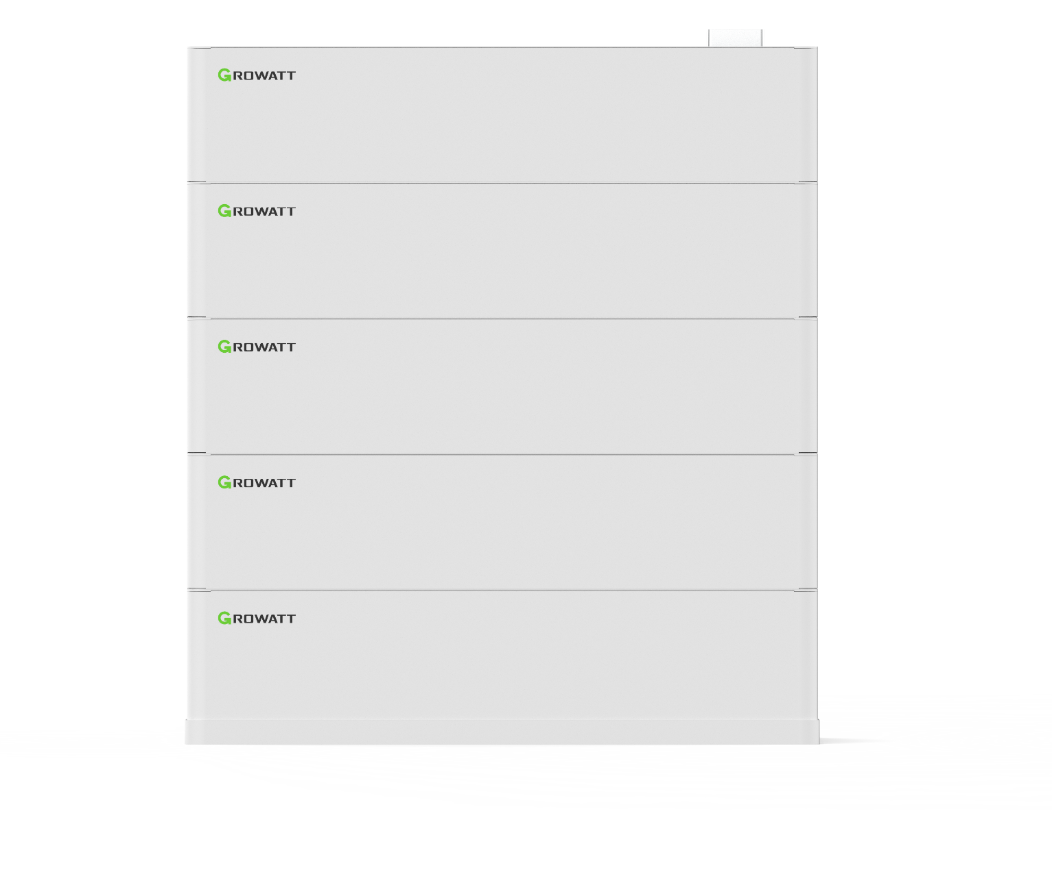
Compatible Battery – ARK 5.1L modular battery
ARK Low Voltage Battery System
IP20, 5.12kWh / Module
Flexible capacity : 5.12kWh ~ 51.2kWh
Excellent safety of cobalt free LiFePO4 battery
Modular stacked design without cable connection
Remote firmware upgrade
Battery Module
ARK 5.1L
Notes:
1. This the modular Low voltage battery, ARK battery, which we promote mostly, single battery module is 2.56kWh, maximum 10 units in parallel reaching 25.6kWh
The materials of the battery is LPF, which guarantee its excellent safety, and easy installation with modular and stacked design.
Also the system supports remote firmware upgrade and monitoring, which can save the maintenance cost in site.

Slide 10
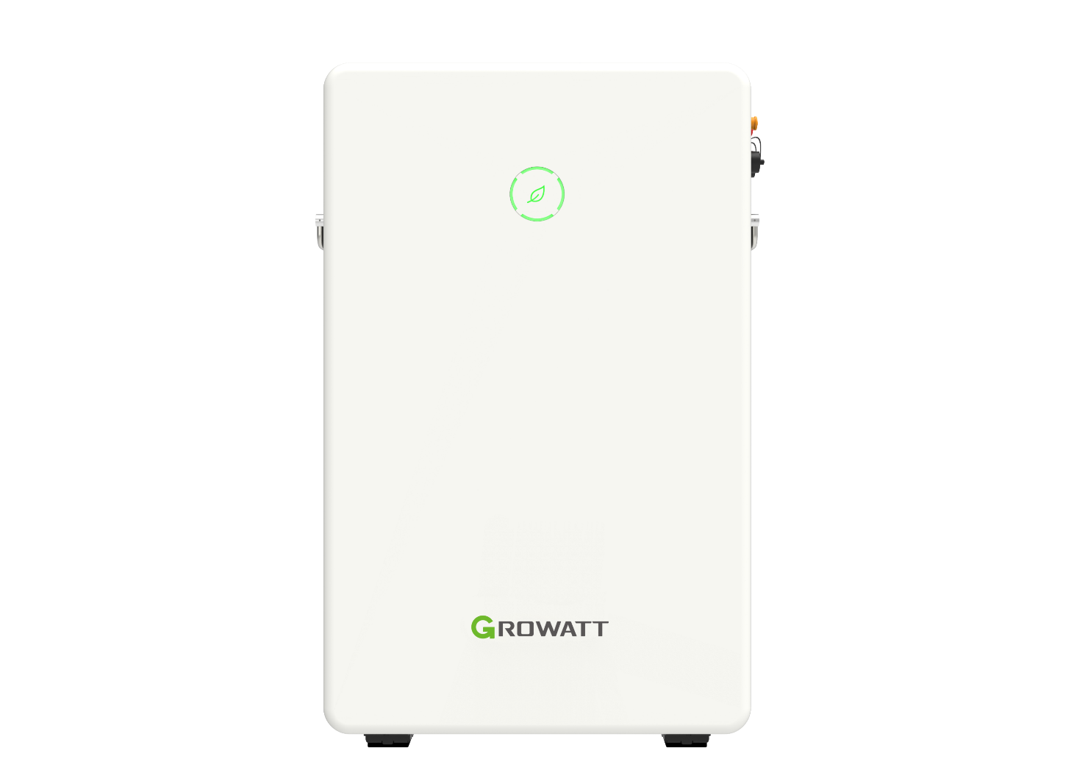
Compatible Battery – GBLI6532
GBLI6532 Battery System
6.5kWh / System
Flexible capacity : 6.5kWh ~ 13 kWh
Excellent safety of cobalt free LiFePO4 battery
Wall-mounted or floor installation
Remote firmware upgrade
Notes:
We also offer the Tower Low voltage option for our customer, GBLI6532, single battery system is 6.5kWh, maximum 2 pcs in parallel reaching 13kWh.

Slide 11
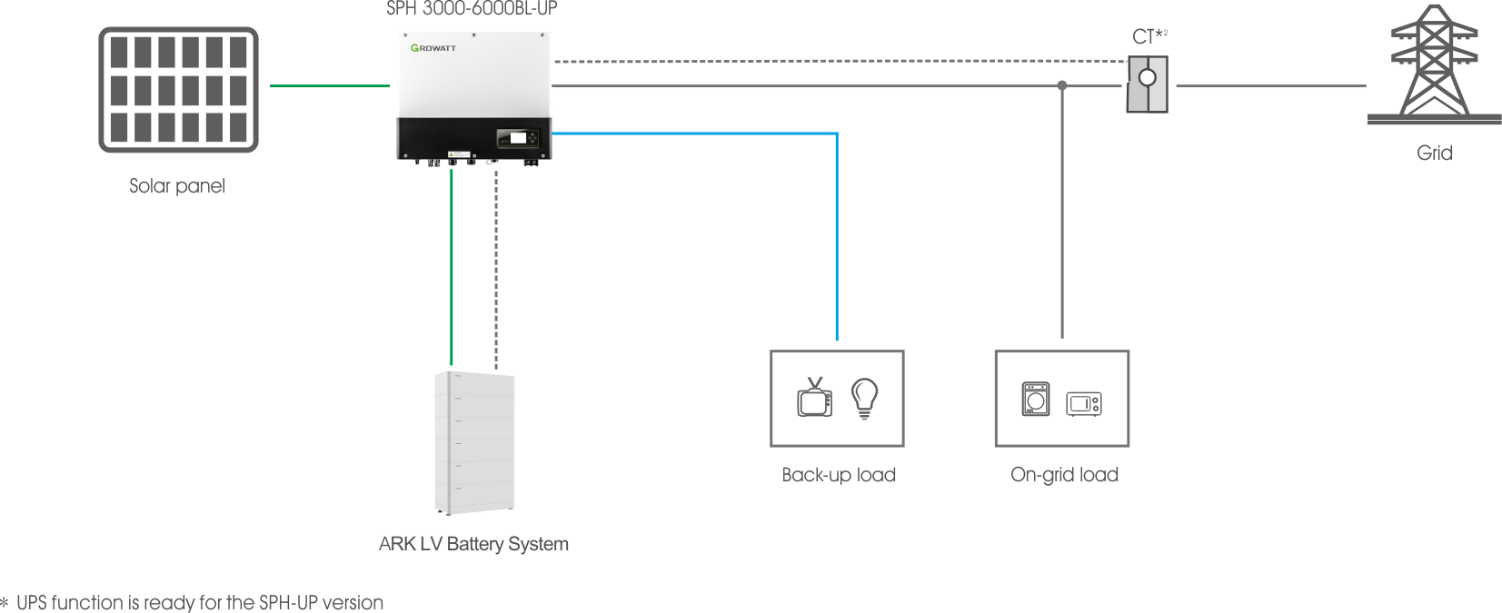
System Solutions – Hybrid Storage System
Single-phase hybrid Inverter for new installation
Growatt offers
SPH 3000-6000TL BL-UP
ARK LV Battery
Meter/CT
Datalogger
ShineSever/ShinePhone
* UPS function for the area where grid is not stable, customer can save the cost of extra backup box

Slide 12
System Solutions – AC Coupled for Retrofit System
Hybrid inverter solution for retrofit project
AC-Coupled function with third-party inverter
* Only support two smart meters during this application, CTs cannot work well

Slide 13
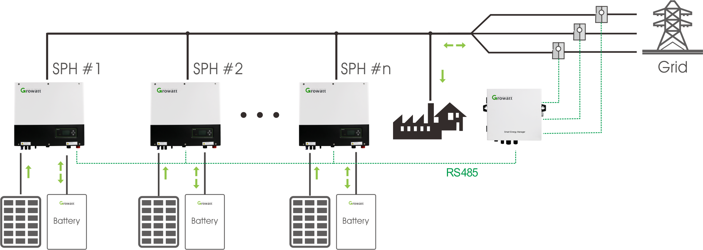
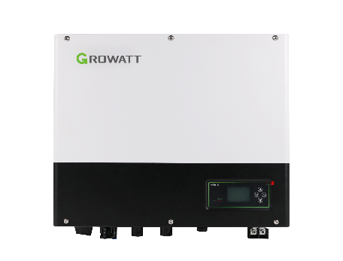
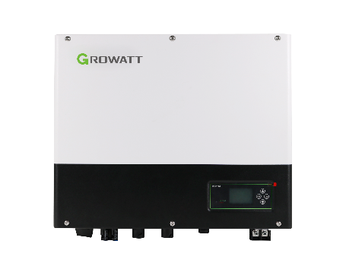
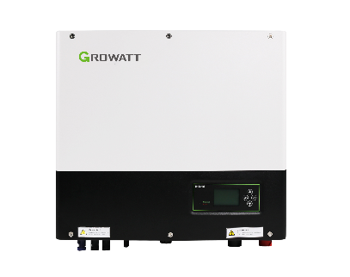
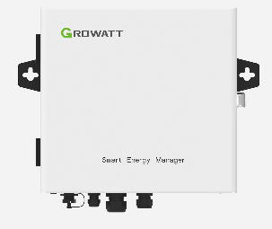
System Solutions – Parallel Extension
Multiple Storage Inverters Work in Parallel
SEM-E
SEM-E as the management center
Max. 10 pcs SPH in parallel operation up to 100kW storage system
Max. 3 pcs SPH in parallel if enabling export limit function

Slide 14


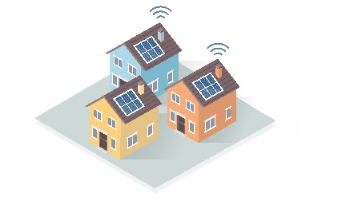
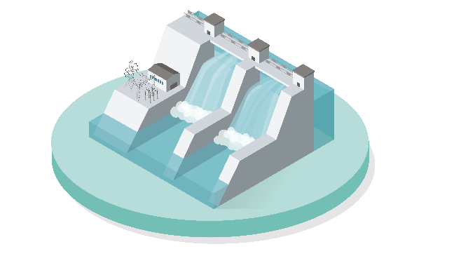
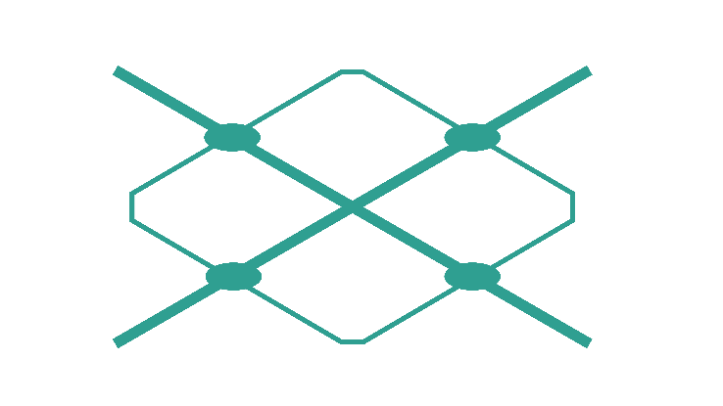
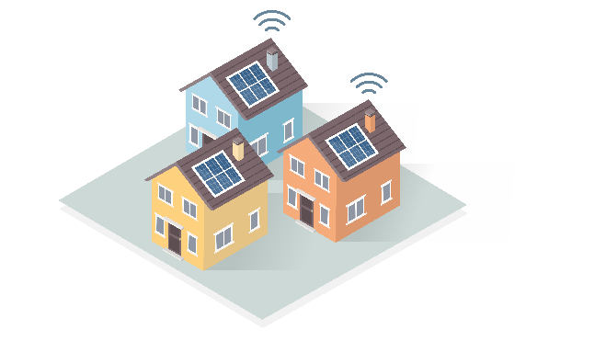

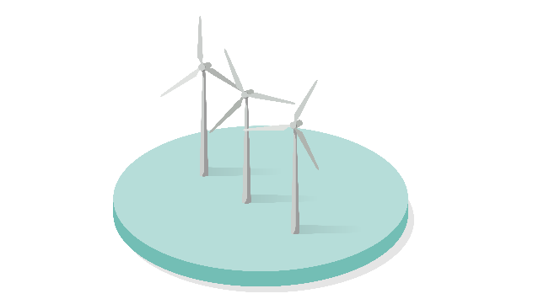
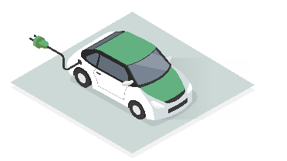
System Solutions – VPP Extension
Virtual Power Plant (VPP)
Growatt ESS solutions provide the access to VPP, already included in the main stream VPP program in Europe and Australia.
With VPP, you’ll have chance to share the power to your neighbors or grid companies to get money, this innovation will help you to achieve the community energy independence.

Slide 15
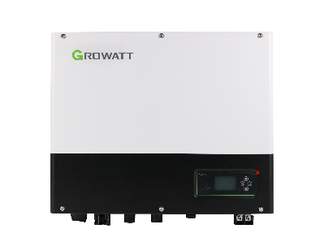
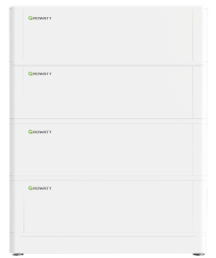
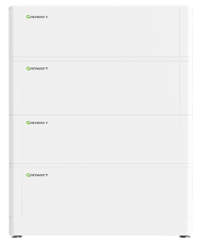
Work Modes – Load First to maximize the solar self-consumption
Load First Mode
Default mode to maximize the solar energy, reduce the power imported from grid
Priority: Load > Battery > Grid
How it works?
solar power is sufficient
solar power is insufficient
OR

Slide 16
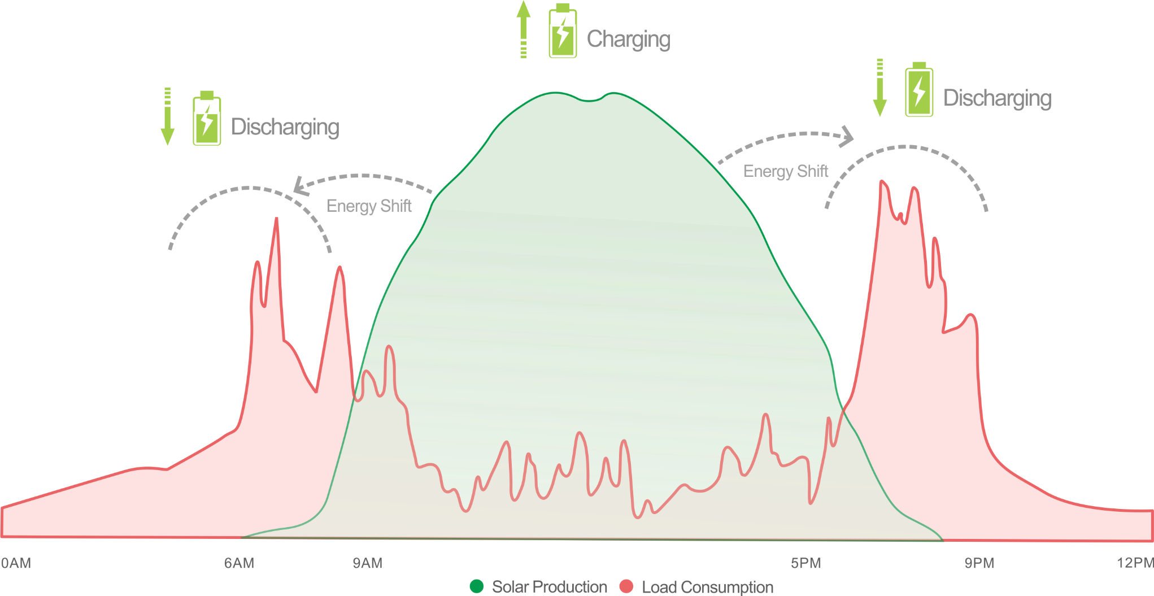
Work Modes – Load First to maximize the solar self-consumption
Load First – to Maximize the Solar Usage
Store energy during the day and use it when solar is weak.
Maximize the solar energy usage, lower the power imported from the grid
Benefits: Maximize the solar self-consumption, more independent from the grid
Load First Mode

Slide 17
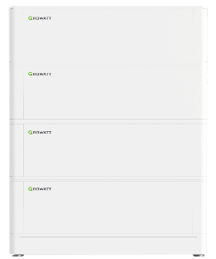
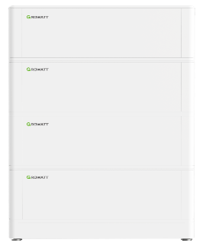
Work Modes – Battery First to guarantee backup for emergency
Battery First Mode
High priority to charge the battery and guarantee enough energy in case blackout happens.
Priority: Battery > Load > Grid
How it works?
solar power is sufficient
solar power is insufficient
OR

Slide 18
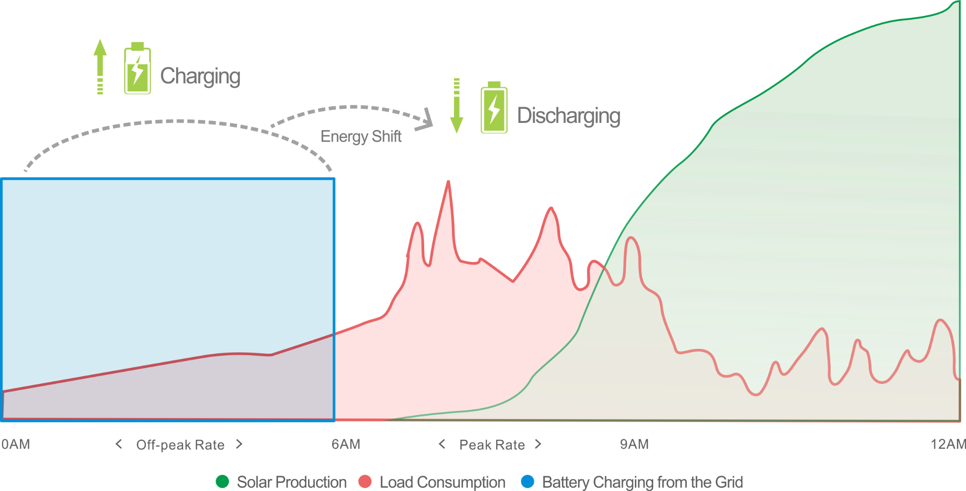
Work Modes – Battery First to reduce your bills using peak/valley price
Battery First - Benefits from Multi-step Electricity
Store power into the battery when the electricity price is in the off-peak rate and use the power in peak rate
Benefits: Reduce the electricity bill, or keep the power on in a blackout
Battery First Mode

Slide 19
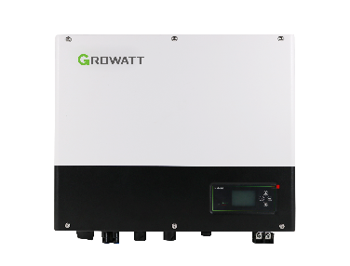
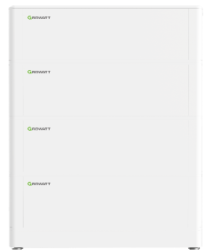
Work Modes – Grid First for grid scheduling
Grid First Mode
Export the energy into grid in response to the grid scheduling
Priority: Load > Grid > Battery
How it works?
solar power is sufficient
solar power is insufficient
OR

Slide 20
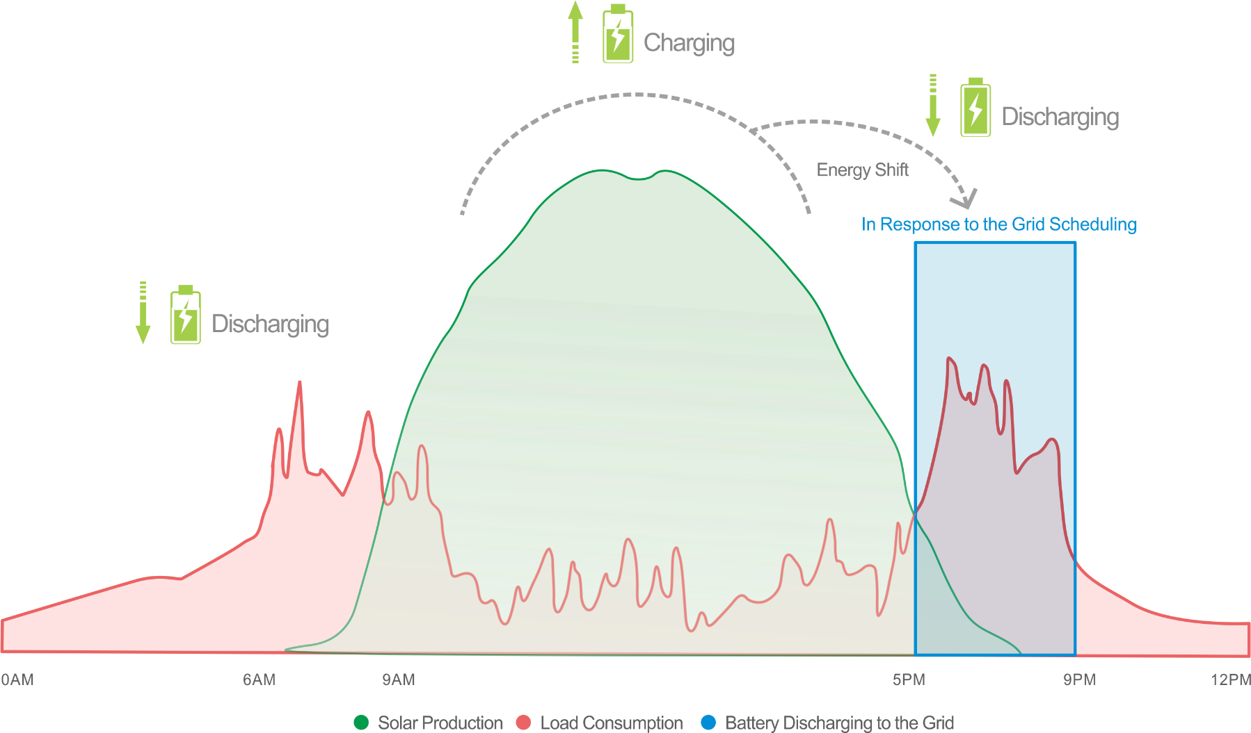
Work Modes – Grid First for grid scheduling
Grid First - Benefits from the Grid Service
Export energy into the grid in response to the grid scheduling
Benefits: Earn more profit
Grid First Mode

Slide 21
